Slide 1





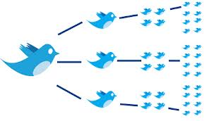




ANALYTICS FOR UNSTRUCTURED DATA MSBA Session 1, 08/22/2023
Dr. Anitesh Barua
David Bruton Jr. Centennial Chair Professor of Business
University of Texas Distinguished Teaching Professor
Department Chair, Information, Risk, and Operations Management (IROM)
McCombs School of Business, University of Texas at Austin
Email: anitesh.barua@mccombs.utexas.edu
Course TA: Pavitra Mohandas (Pavitra.Mohandas@utexas.edu)

Slide 2
Learning Objectives
Course details
Why bother about unstructured data
The role of Large Language Models (LLM) in modern NLP
Contemporary business applications & use cases

Slide 3
A Serious Analytics Course, But What is the Connection to Business?
Which brands do people compare with entry level Mercedes cars?
How can we predict which brands and models customers will switch from to, say, a Tesla?
How can we recommend products that meet specific customer requirements?
How can we predict the sales of a new product that is yet to be released?
How does Netflix figure out what will be a hit series?
How does Airbnb predict which images and descriptions get a property rented faster?
Yes, it connects to business!
© Anitesh Barua, 2023

Slide 4
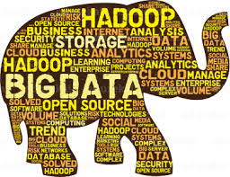
User Generated Content Analytics
User Generated Content (UGC) = unstructured data (text, images, audio, video), structured data is numeric
Two sources of UGC
External: Social media, public documents (e.g., shareholder reports)
Internal: HR evaluations, contracts, vendor reports, customer conversations, maintenance reports, medical reports, etc.
© Anitesh Barua, 2023

Slide 5

When Numeric Data Don’t Explain Differences in Preferences
Similar demographics, but very different preferences in music
Yet, unstructured data (e.g., blogs) can predict much more accurately
Computer Science, 26
likes country music
Engineer, 27
likes R&B
Economics, 25,
likes R&B
Engineer, 27
likes jazz
Engineer, 26,
likes prog
rock
© Anitesh Barua, 2023

Slide 6

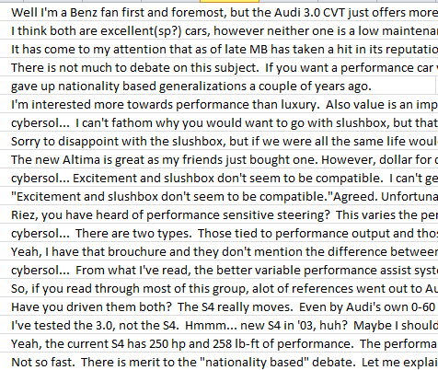
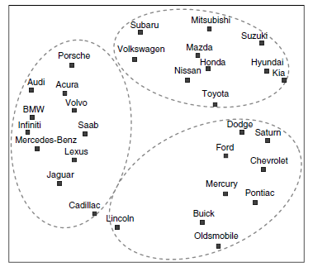
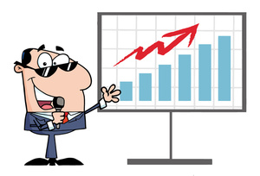



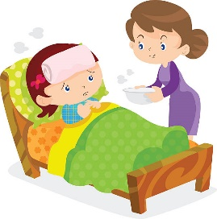
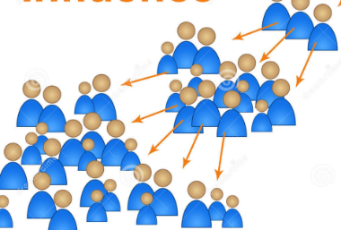
The Untapped Potential of Unstructured Data
Obtain insights: Analyze brand & product associations, predict switching
Build crowdsourced
recommendation
systems
Predict:
E.g., salesrank,
retention, spend,
etc.
Metrics & analytics
Create new
products/services
X
Who matter most: Find influencers
Detect bots, trolls in networks
Analyze real-time events
© Anitesh Barua, 2023

Slide 7
Before and After this Course
Do you know how to | Yes/No
Extract conversations in online forums, blogs, Youtube, etc.?
Analyze unstructured data to generate new business insights and discover facts?
Leverage the wisdom of the crowd to create new products/services?
Analyze consumer sentiments using supervised and unsupervised methods?
Predict business outcomes (e.g., sales) from social data?
Assess resonance between a message (e.g., a campaign) & response?
Leverage the power of images in making business predictions?
Generate new content with LLMs to address business problems?
© Anitesh Barua, 2023

Slide 8
Final Project (Group Presentations)
You are a consultant to a brand, organization, politician, etc.
Objectives: Obtain actionable insights from social mentions using unstructured data analytics
Analysis of competing brands or products
E.g., airlines, automobiles, hotels, smartphones, etc.
Track events (e.g., political) or marketing campaigns
Whether social mentions reflect the intended messages
Predict outcomes from social chatter
E.g., box office revenues, stock prices, etc.
Develop a crowdsourced recommender system
Explore the role of LLMs
© Anitesh Barua, 2023

Slide 9

Tools, Techniques, ….
Python scripts
Write your own scripts
No coding taught in class (but TA will help if/when required)
Scrapers & data access tools (TA will provide demos)
GitHub is your friend

Slide 10
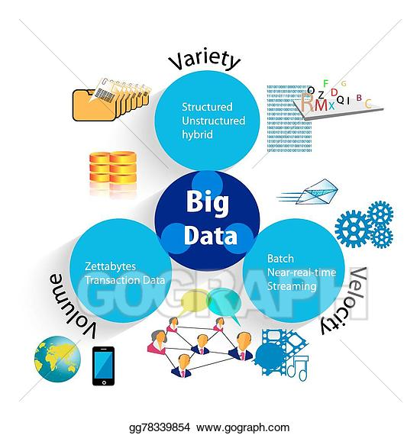
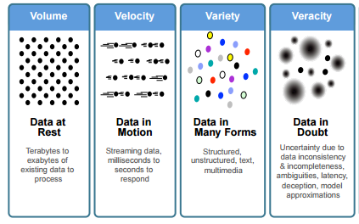
Unstructured Data and Four Vs
What has unstructured data got to do with the Vs?
Source: IBM

Slide 11
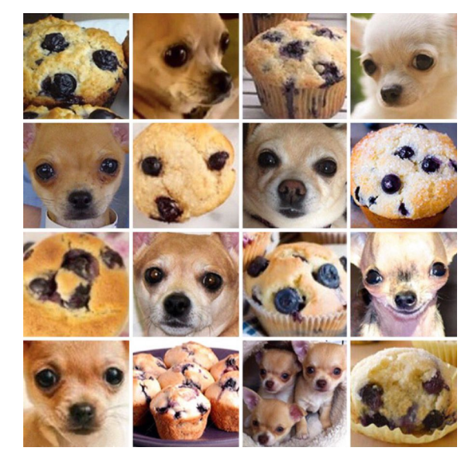
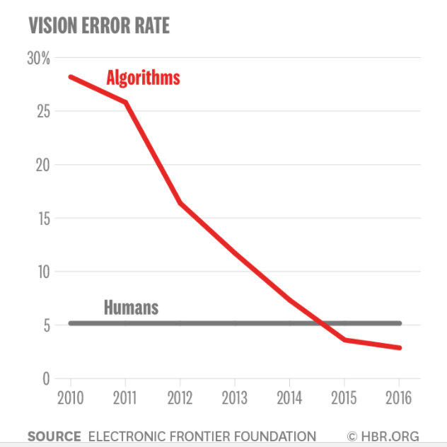
Image Analytics: Puppy or Muffin?
Source: Erik Brynjolfsson

Slide 12

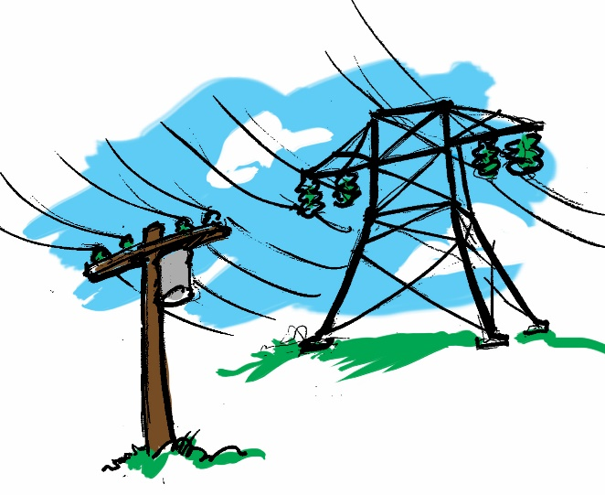
Business Applications With Unstructured Big Data
Healthcare
Which CHF patients will be readmitted?
Free-form inputs (text) about lifestyle most important predictor
Electric grid failures
Traditional models
Enriching with text
© Anitesh Barua, 2023

Slide 13

“Told Ya, it’s all Fake!”
When machine learning generates (fake) reviews (2012)
Easily my favorite Italian restaurant. I love the taster menu, everything is amazing on it. I suggest the carpaccio and the asparagus. Sadly it has become more widely known and becoming difficult to get a reservation for prime times.
My family and I are huge fans of this place. The staff is super nice and the food is great. The chicken is very good and the garlic sauce is perfect. Ice cream topped with fruit is delicious too. Highly recommended!
I come here every year during Christmas and I absolutely love the pasta! Well worth the price!
Excellent pizza, lasagna and some of the best scallops I've had. The dessert was also extensive and fantastic.
The food here is freaking amazing, the portions are giant. The cheese bagel was cooked to perfection and well prepared, fresh & delicious! The service was fast. Our favorite spot for sure! We will be back!
I have been a customer for about a year and a half and I have nothing but great things to say about this place. I always get the pizza, but the Italian beef was also good and I was impressed. The service was outstanding. The best service I have ever had. Highly recommended.
1, 3 & 4 are real, 2, 5 and 6 are fake

Slide 14
Natural Language Processing
Similarity
Summarization
(topics, sentiments, etc.)
Associations
NLP
Predictions
Generative
© Anitesh Barua, 2023

Slide 15
Evolution of Language Models
Represent words as numbers (bag-of-words)
From bag-of-words to word embeddings (2014)
From word embeddings to attention & transformers (2017)
Better representations of words and their relationships
Superior understanding of a language
BERT: Encoder side of transformers (2018)
The GPT family (starting 2018): Decoder side of transformers
© Anitesh Barua, 2023

Slide 16
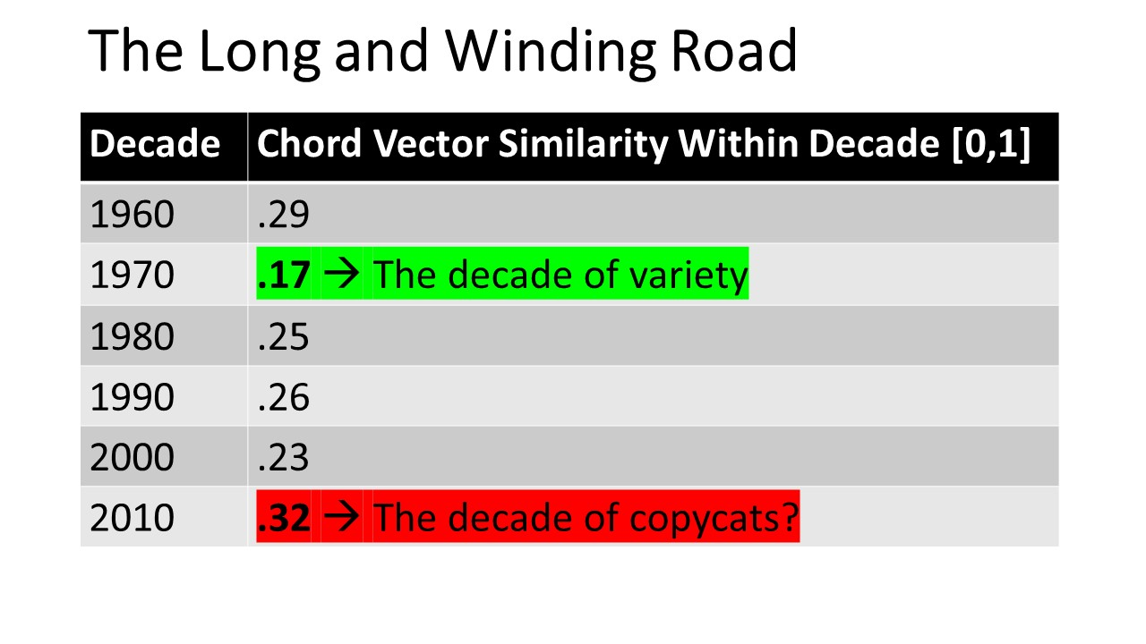
A Stellar UDA Project
Done overnight with 2 days (= 16 hours!) of teaching

Slide 17
Takeaways and Upcoming Attractions!
Unstructured data can be more informative than structured data
Rapidly gaining visibility in the industry
Latest advances in ML and AI are more about unstructured than structured data!
Includes networks of user interactions
Upcoming (8/24): Knowledge discovery and deep insights from user generated content

